Slide 1
Autoregressive Integrated Moving Average (ARIMA) Models Part 1

Slide 2
Introduction
What is the disadvantage of exponential smoothing and regression models???

Slide 3
White noise
A time series (w_{t}: t = 1, 2, …, T} is discrete white noise if the variables w₁, w₂, …, w_{T} are independent and identically distributed with a mean zero. This implies that the variables all have the same variance σ2 and Cov(w_{i}, w_{j}) = 0 for all i ≠ j. If, in addition, the variables also follows a normal distribution, the series is called Gaussian white noise.

Slide 4
White noise
The autocorrelation function follows as

Slide 5
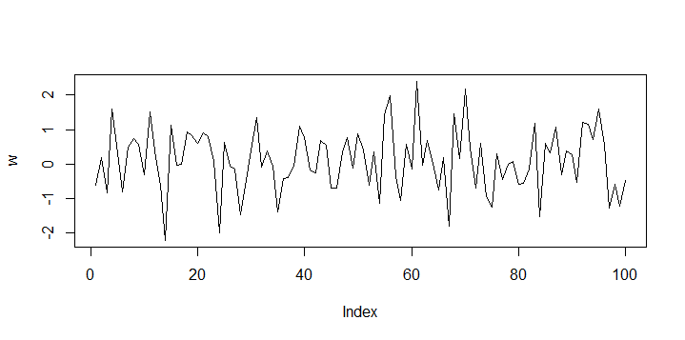
White noise
set.seed(1) w <-rnorm(100) plot(w, type = "l")
Time plot of simulated Gaussian white noise series

Slide 6
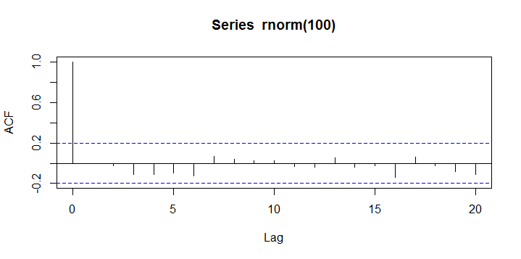
White noise series - acf
set.seed(1) acf(rnorm(100))
>

Slide 7
5.2 Linear Models for Stationary Time Series
A linear filter is defined as
is said to be

Slide 8
Stationarity
What are the three conditions for second-order stationary???

Slide 9
Stationarity

Slide 10
Some Examples

Slide 11
Some Examples

Slide 12
Stationary Time Series
Many time series do not exhibit a stationary behavior.
True stationarity is in fact a rarity in real life.
However it provides a foundation to build upon since (as we will see later on) if the time series in not stationary, its first difference (y_{t}-y_{t-1}) will often be stationary.

Slide 13
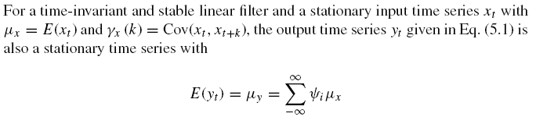
Linear Filter

Slide 14
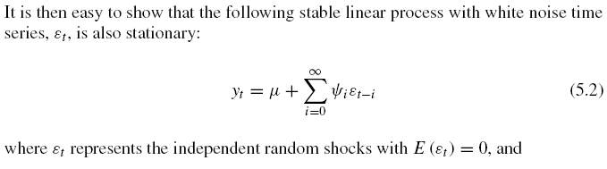
If Input is White Noise
Var(ε_{t}) = σ² for all t.

Slide 15
Using the Backshift Operator

Slide 16
Wold’s Decomposition Theorem
Any nondeterministic weakly stationary time series can be written as an infinite sum of weighted random shocks (disturbances)
where

Slide 17
How useful is this?
Well, not so much!!!
How can we come up with “infinitely” many terms?

Slide 18
Maybe we should consider some special cases:

Slide 19
Section 5.3 Finite Order Moving Average Processes - Ma(q)

Slide 20
Some Properties
Expected Value
Variance

Slide 21

Some Properties
Expected Value
Variance

Slide 22
Some Properties
Autocovariance Function

Slide 23
Some Properties
Autocovariance Function

Slide 24
Autocorrelation Function of MA(q)
ACF of Ma(q) _________________.
This is very useful in the identification of an MA(q) process

Slide 25
Autocorrelation Function of MA(q)
ACF of Ma(q) “cuts off” after lag q
This is very useful in the identification of an MA(q) process

Slide 26
Sample ACF
Will not be equal to zero after lag q for an MA(q)
But it will be small
For the same size of N, this can be tested using the limits:

Slide 27
First-Order Moving Average Process MA(1)
for which autocovariance and autocorrelation functions are given as

Slide 28
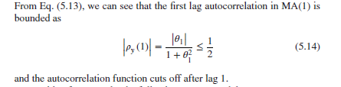

Slide 29
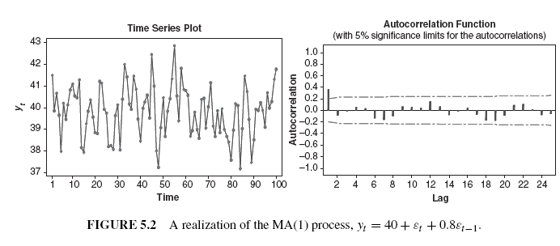
Note, the behavior
of sample ACF

Slide 30
Second-Order Moving Average Process MA(2)
for which autocovariance and autocorrelation functions are given as

Slide 31
An Example

Slide 32
Simulation MA(3) process
set.seed(1)
b <- c(0.8, 0.6, 0.4)
x <- w <- rnorm(1000)
for (t in 4:1000) {for (j in 1:3) x[t] <- x[t] +b[j]*w[t-j]}
plot(x, type = "l")
ma3acf<-acf(x)

Slide 33
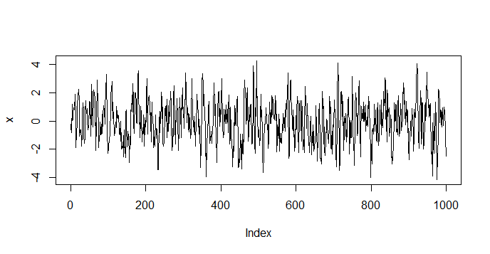
Time plot MA(3)

Slide 34
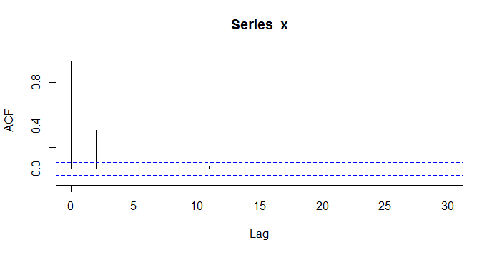
Correlogram MA(3)

Slide 35
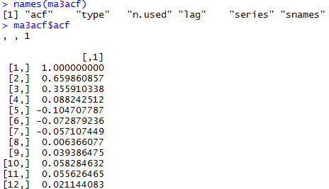

Slide 36
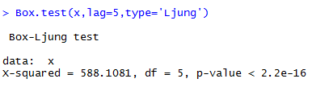
Joint test for autocorrelation
One of the test is Box-Ljung test.

Slide 37
Model fitted to simulated series
An MA(q) model can be fitted to data in R using arima function with the order function parameter set to c(0, 0, q).

Slide 38
